Slide 1

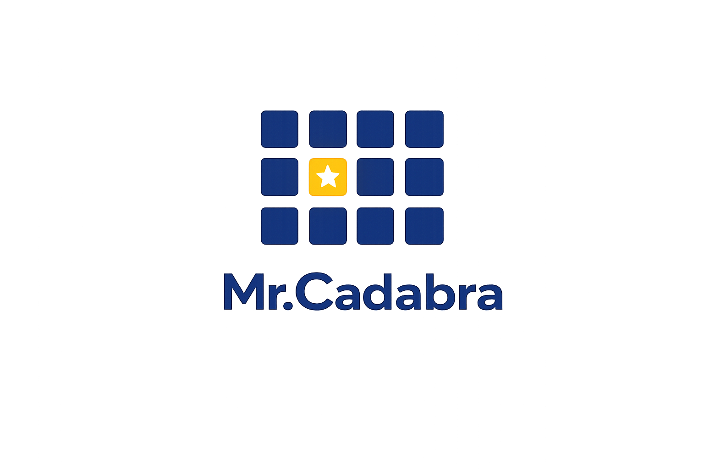
• FOR HOMESCHOOL FAMILIES •
— AI-Powered Tutor —
Your child's personal math tutor
Patient, adaptive math tutoring with automatic homeschool records.
mrcadabra.com
Notes:
Homeschooling math is a big job. Mr. Cadabra is a patient, personal math tutor — and while he teaches, he keeps your homeschool records automatically.
**Slide 1 — See your whole class at a glance.** If you teach math to more than one student — a co-op, a microschool, or a classroom — here's what Mr.Cadabra looks like from the front of the room. **Slide 2 — Every student, tutored one-on-one.** Every student in your class gets the same patient one-on-one tutor, working at their own placed level. That means intervention without stigma — a ninth grader can quietly rebuild fractions without ever seeing a grade level on screen. **Slide 3 — The mastery heatmap.** This is your classroom view: the mastery heatmap. Every cell is a student's best real check score on a unit — gold stars mean mastered. And "needs attention" names the unit your whole class is weakest on, so you know exactly what to reteach. **Slide 4 — Drill into any student.** Click any name and you get that student's full dashboard — their units, their accuracy, their streak, and honest time-on-task where idle minutes never count. It's the picture you'd build by hand, already built. **Slide 5 — Built for real classrooms.** It's built for the realities of a classroom. You add students by code — no student emails, no new personal data. There are no microphones to manage; headphones are all you need. And the built-in course assessment maps each student's strengths for you. **Slide 6 — Pilot it free this term.** We're partnering with a limited number of classrooms this term: you get Mr.Cadabra free for the pilot, we get your honest feedback. Email support@mrcadabra.com and tell us about your class.

Slide 2
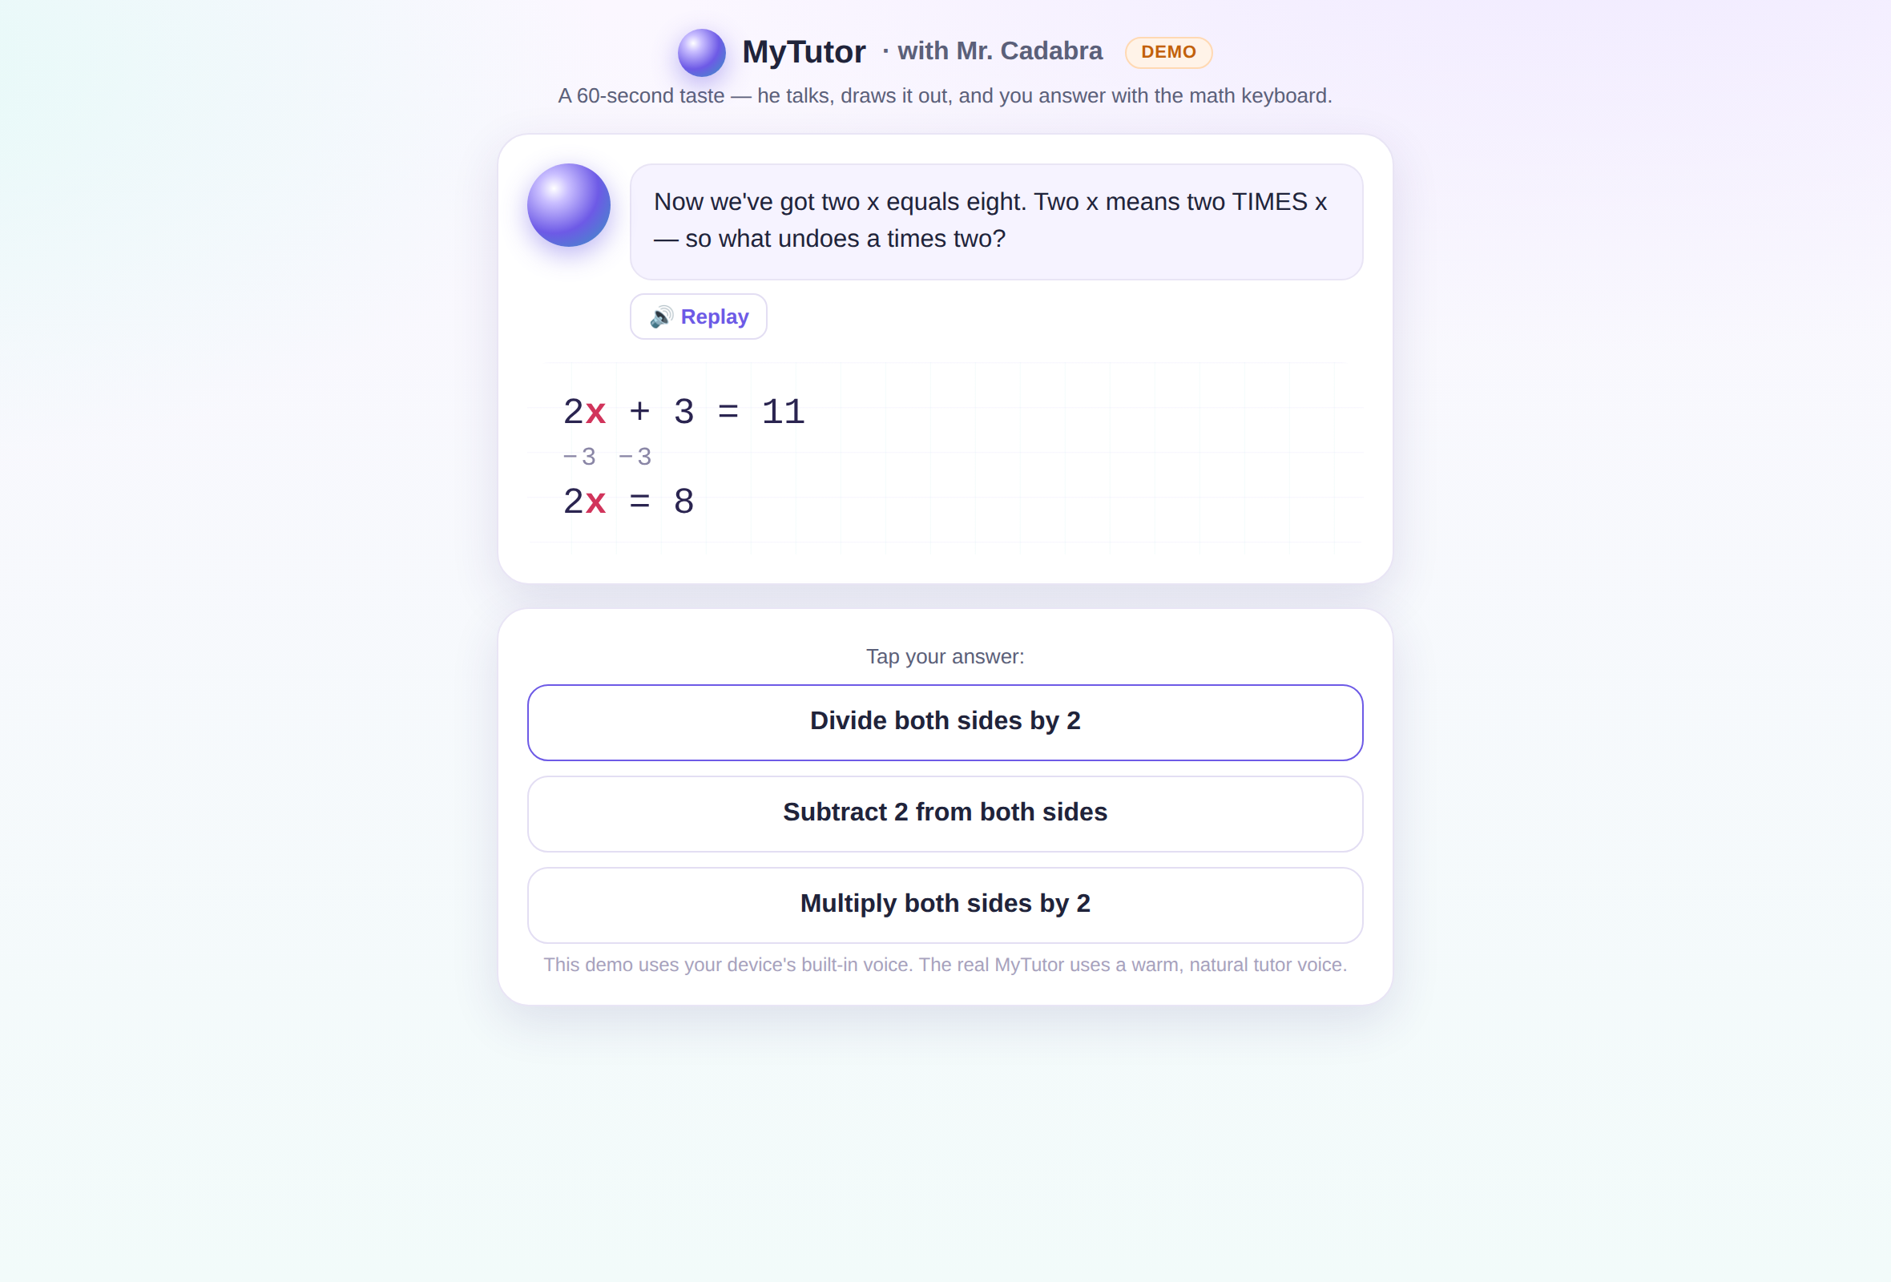

He teaches out loud, step by step
Mr.Cadabra talks your student through every problem, draws every step, and listens as they answer out loud.
Ten complete courses, from Entry-Level Math through Differential Equations.
Notes:
He teaches every lesson out loud, step by step, and listens as your student answers — ten complete courses, from Entry-Level Math through Differential Equations.

Slide 3
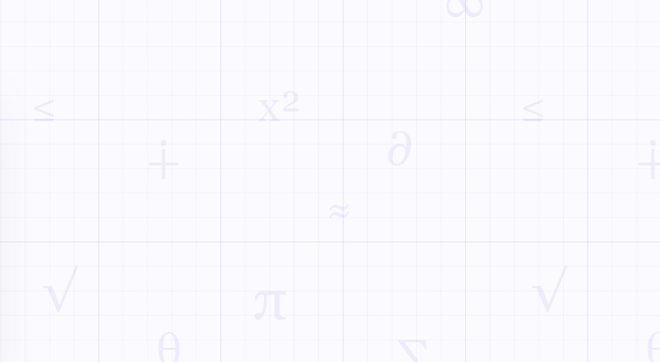
Assessment
A placement test finds where your student starts.
Periodic exams verify when they're ready to move on.
Notes:
A placement test finds where your student starts, and real exams verify when they're ready to move on.

Slide 4
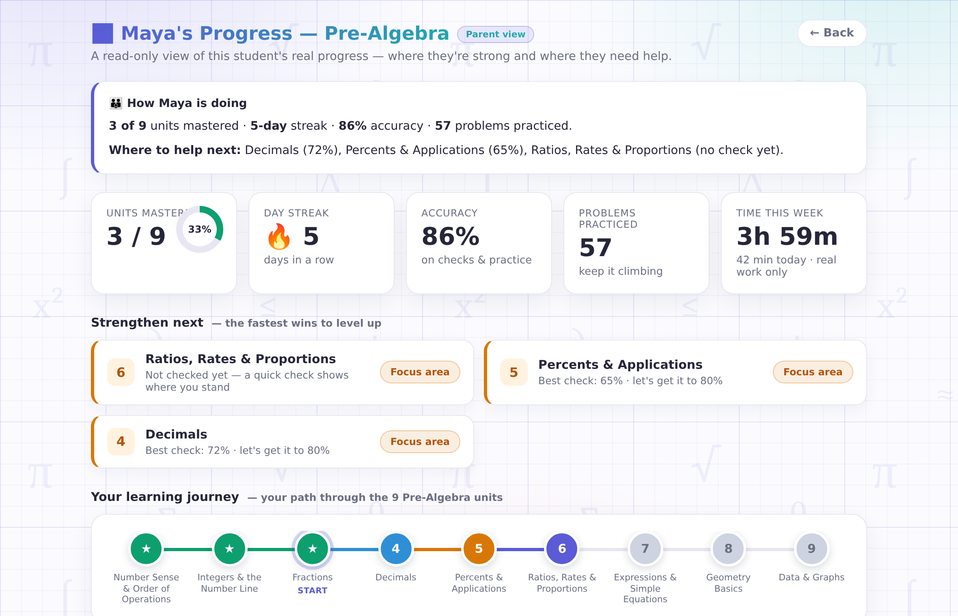

Watch the progress without hovering
Your read-only parent view shows what's mastered, what needs work, and exactly where to help next — updated after every lesson. A weekly email keeps you posted, and you can steer the pace anytime.
Notes:
Your read-only parent view shows what's mastered, what needs work, and where to help next. You're still the teacher — you set the pace.

Slide 5
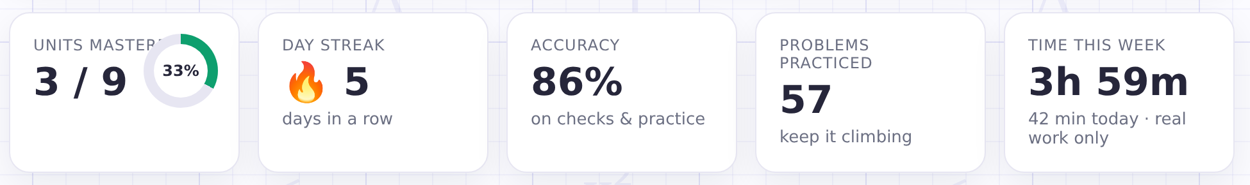
When logging hours is effortless
Instructional hours logs are kept automatically by Mr.Cadabra.
A minute counts only when your student is actually working.
Notes:
Instructional hours log themselves. A minute counts only when your student is actually working.

Slide 6



Homeschool records—done.
★
An hours log
A printable plan
Mastery evidence
Honest instructional minutes per day and per course, kept for you automatically.
Every course page doubles as a scope & sequence — print it for portfolios and filings.
Scored checks and assessment results — demonstrated skill, not just attendance.
Notes:
The hours log, a printable course plan, and real mastery evidence — your records, ready whenever you need to show your work.

Slide 7
Ready to meet Mr.Cadabra?
— AI-Powered Tutor —
Try your first lesson free—no credit card needed.
mrcadabra.com/homeschool
Become one of our first homeschool families to receive introductory pricing
and help shape what’s next.
Notes:
Try the first lesson free — no credit card needed — at mrcadabra.com/homeschool.

